Slide 1

Fabrication of graphitic-carbon suspended nanowires through mechanoelectrospinning of photocrosslinkable polymers
A Osamu Katagiri Tanaka A01212611@itesm.mx
23 Jan 2020

Slide 2
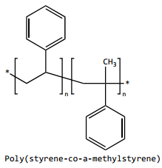
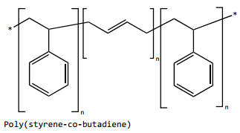
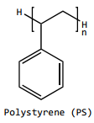
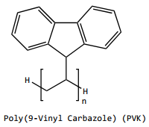
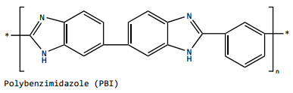
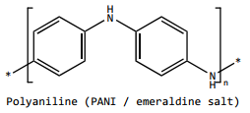
Discover a new polymer solution to beat Braulio’s record
Study solutions with high carbon polymers and no oxygen.
No records
in THF & DMF
in THF
● FFES
● NFES
No records
in NMP
in Styrene

Slide 3
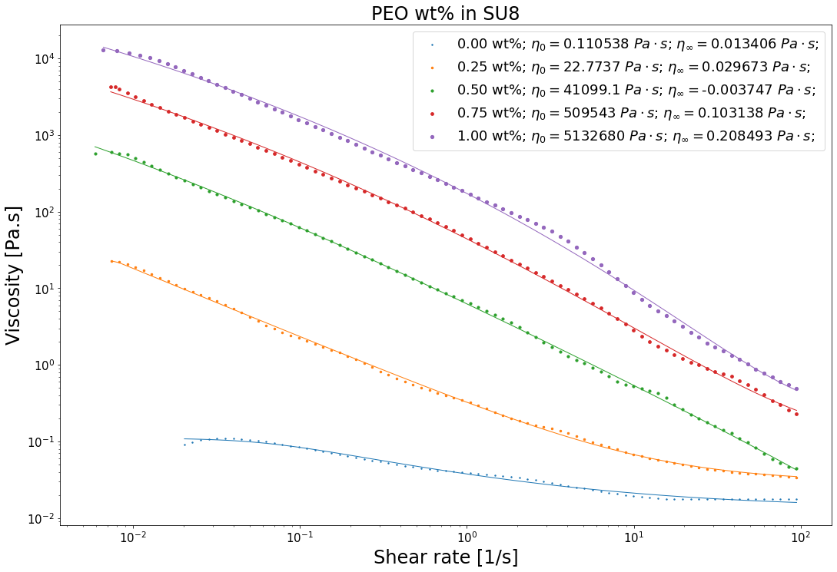

Slide 4
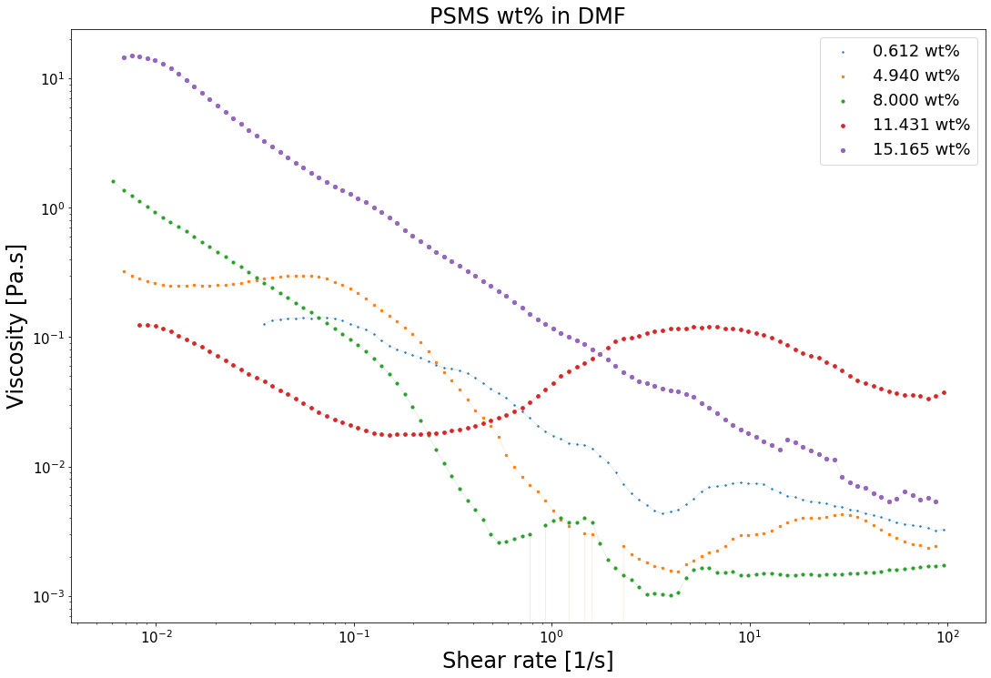
14.0815 Pa.s

Slide 5
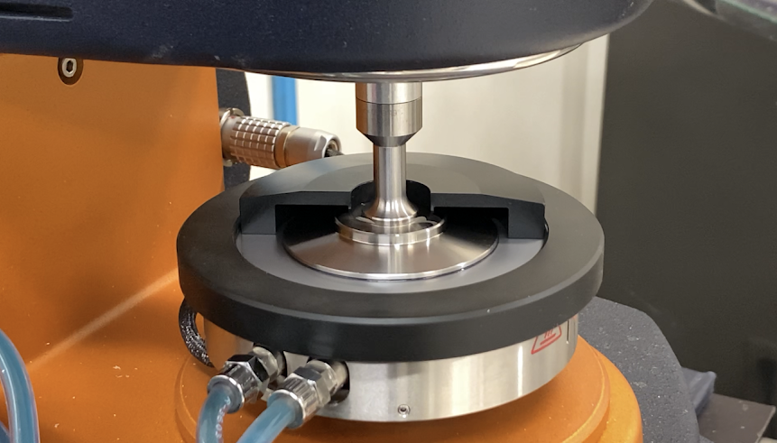

Slide 6
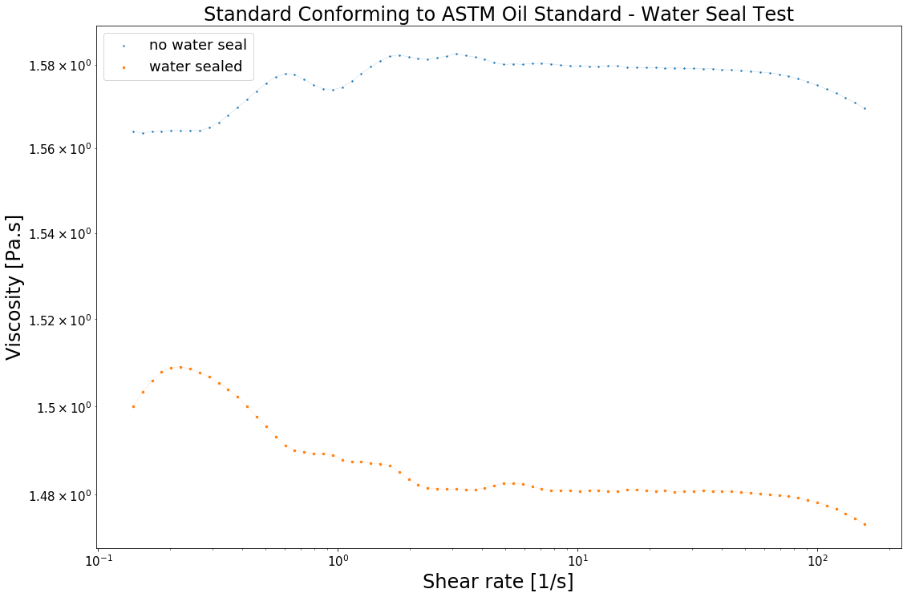
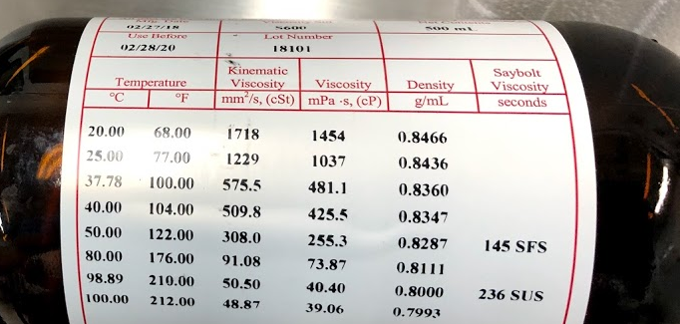

Slide 7

Q&A

Slide 8
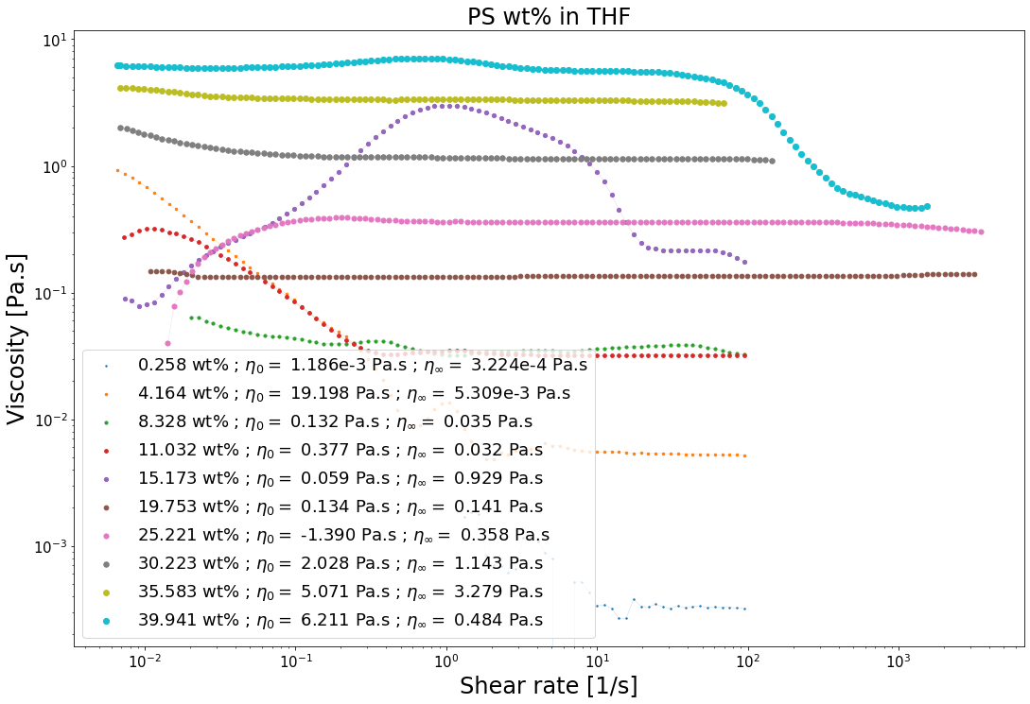

Slide 9
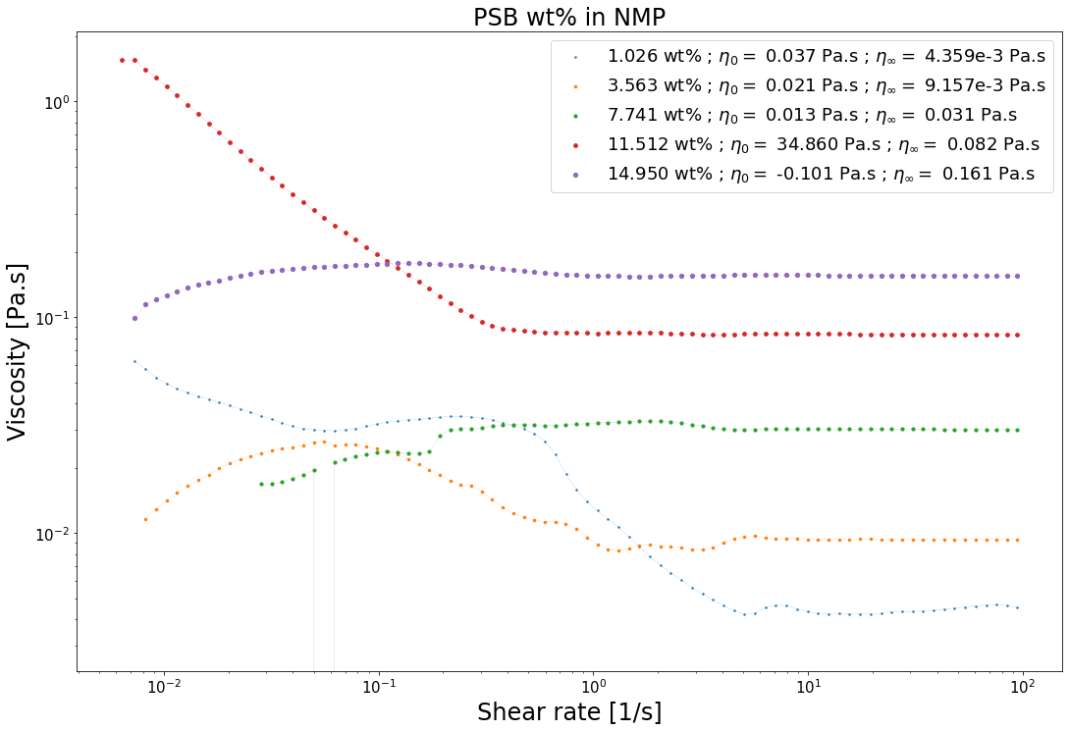

Slide 10
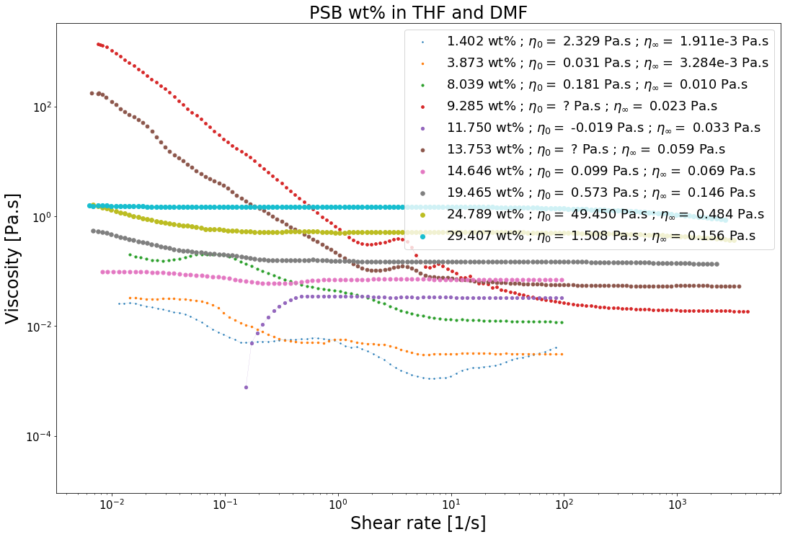

Slide 11
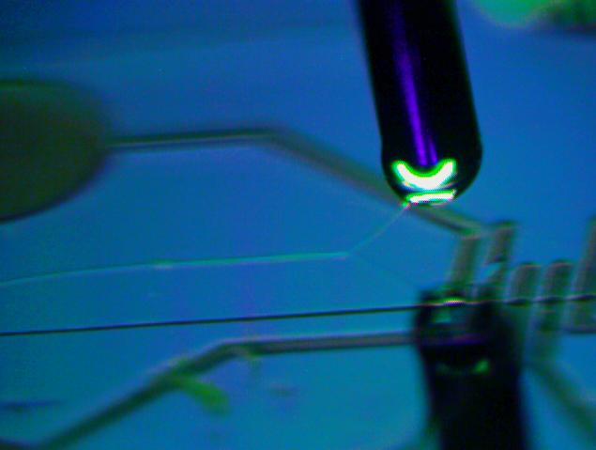
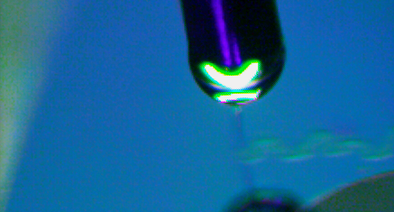
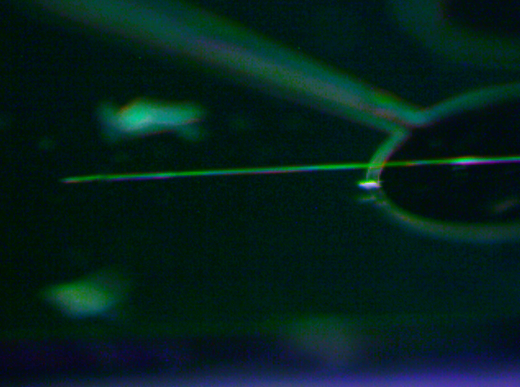
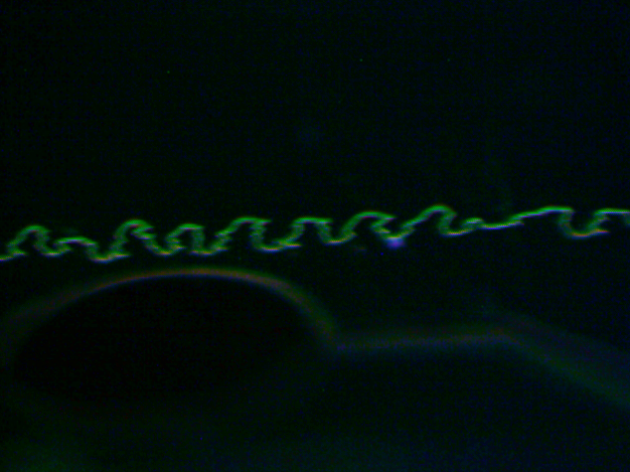
Characterization of the 0.25 wt% PEO Solution
Electrospun-able with an applied voltage of 600V.
Unable to initiate the jet at 500V or lower.
600V
700V
Notes:
Surface t-

Slide 12
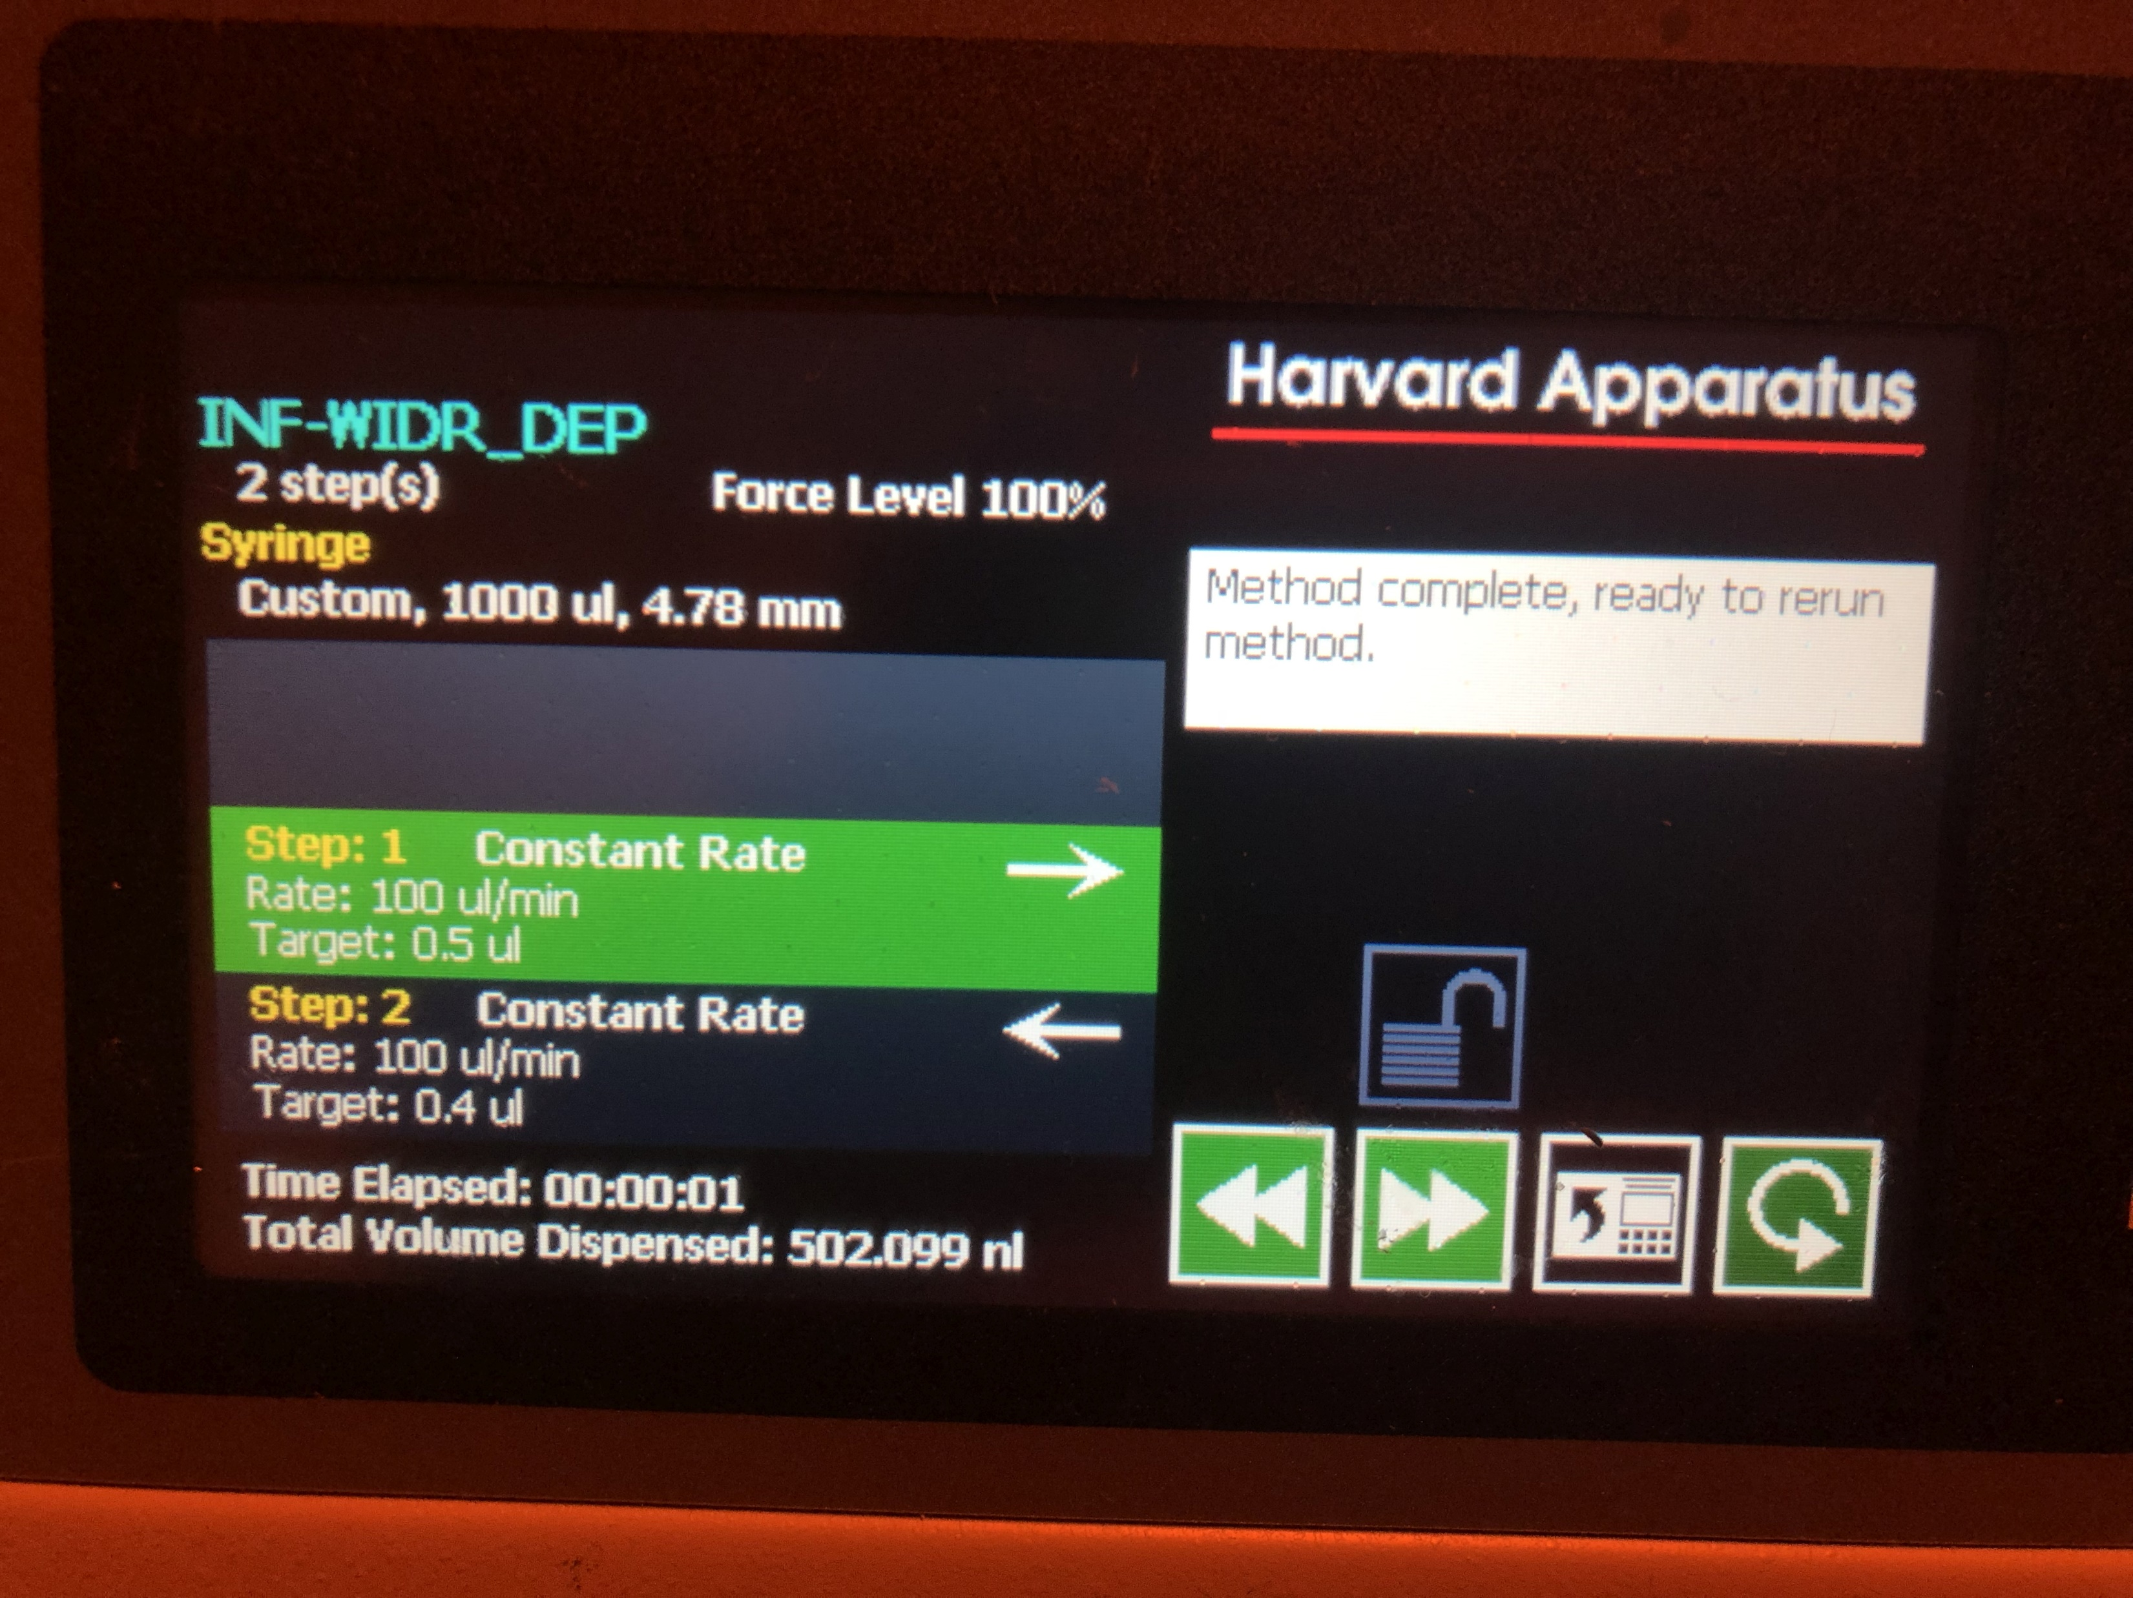
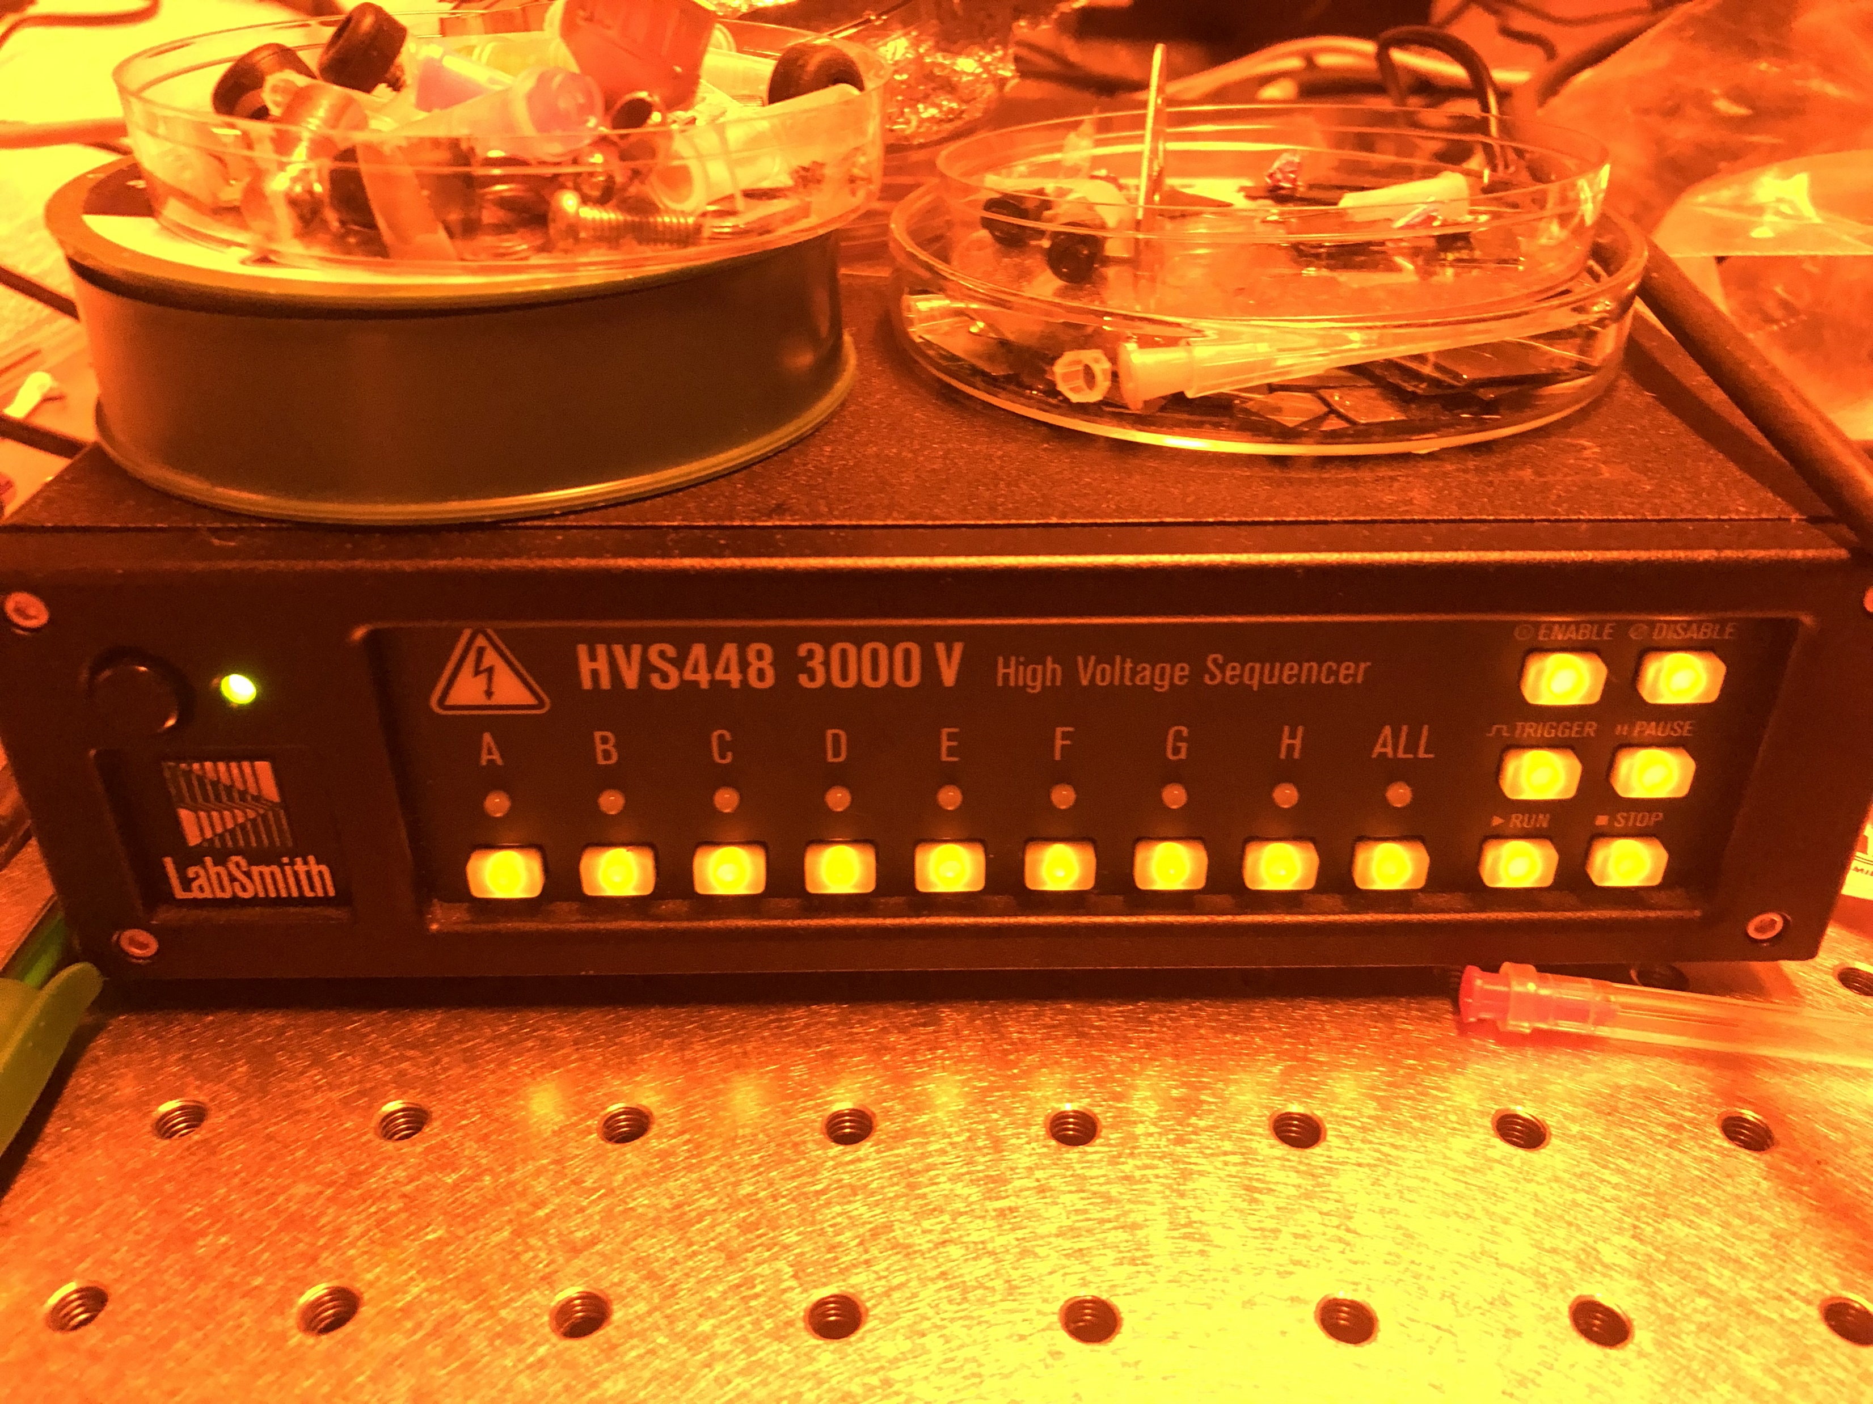
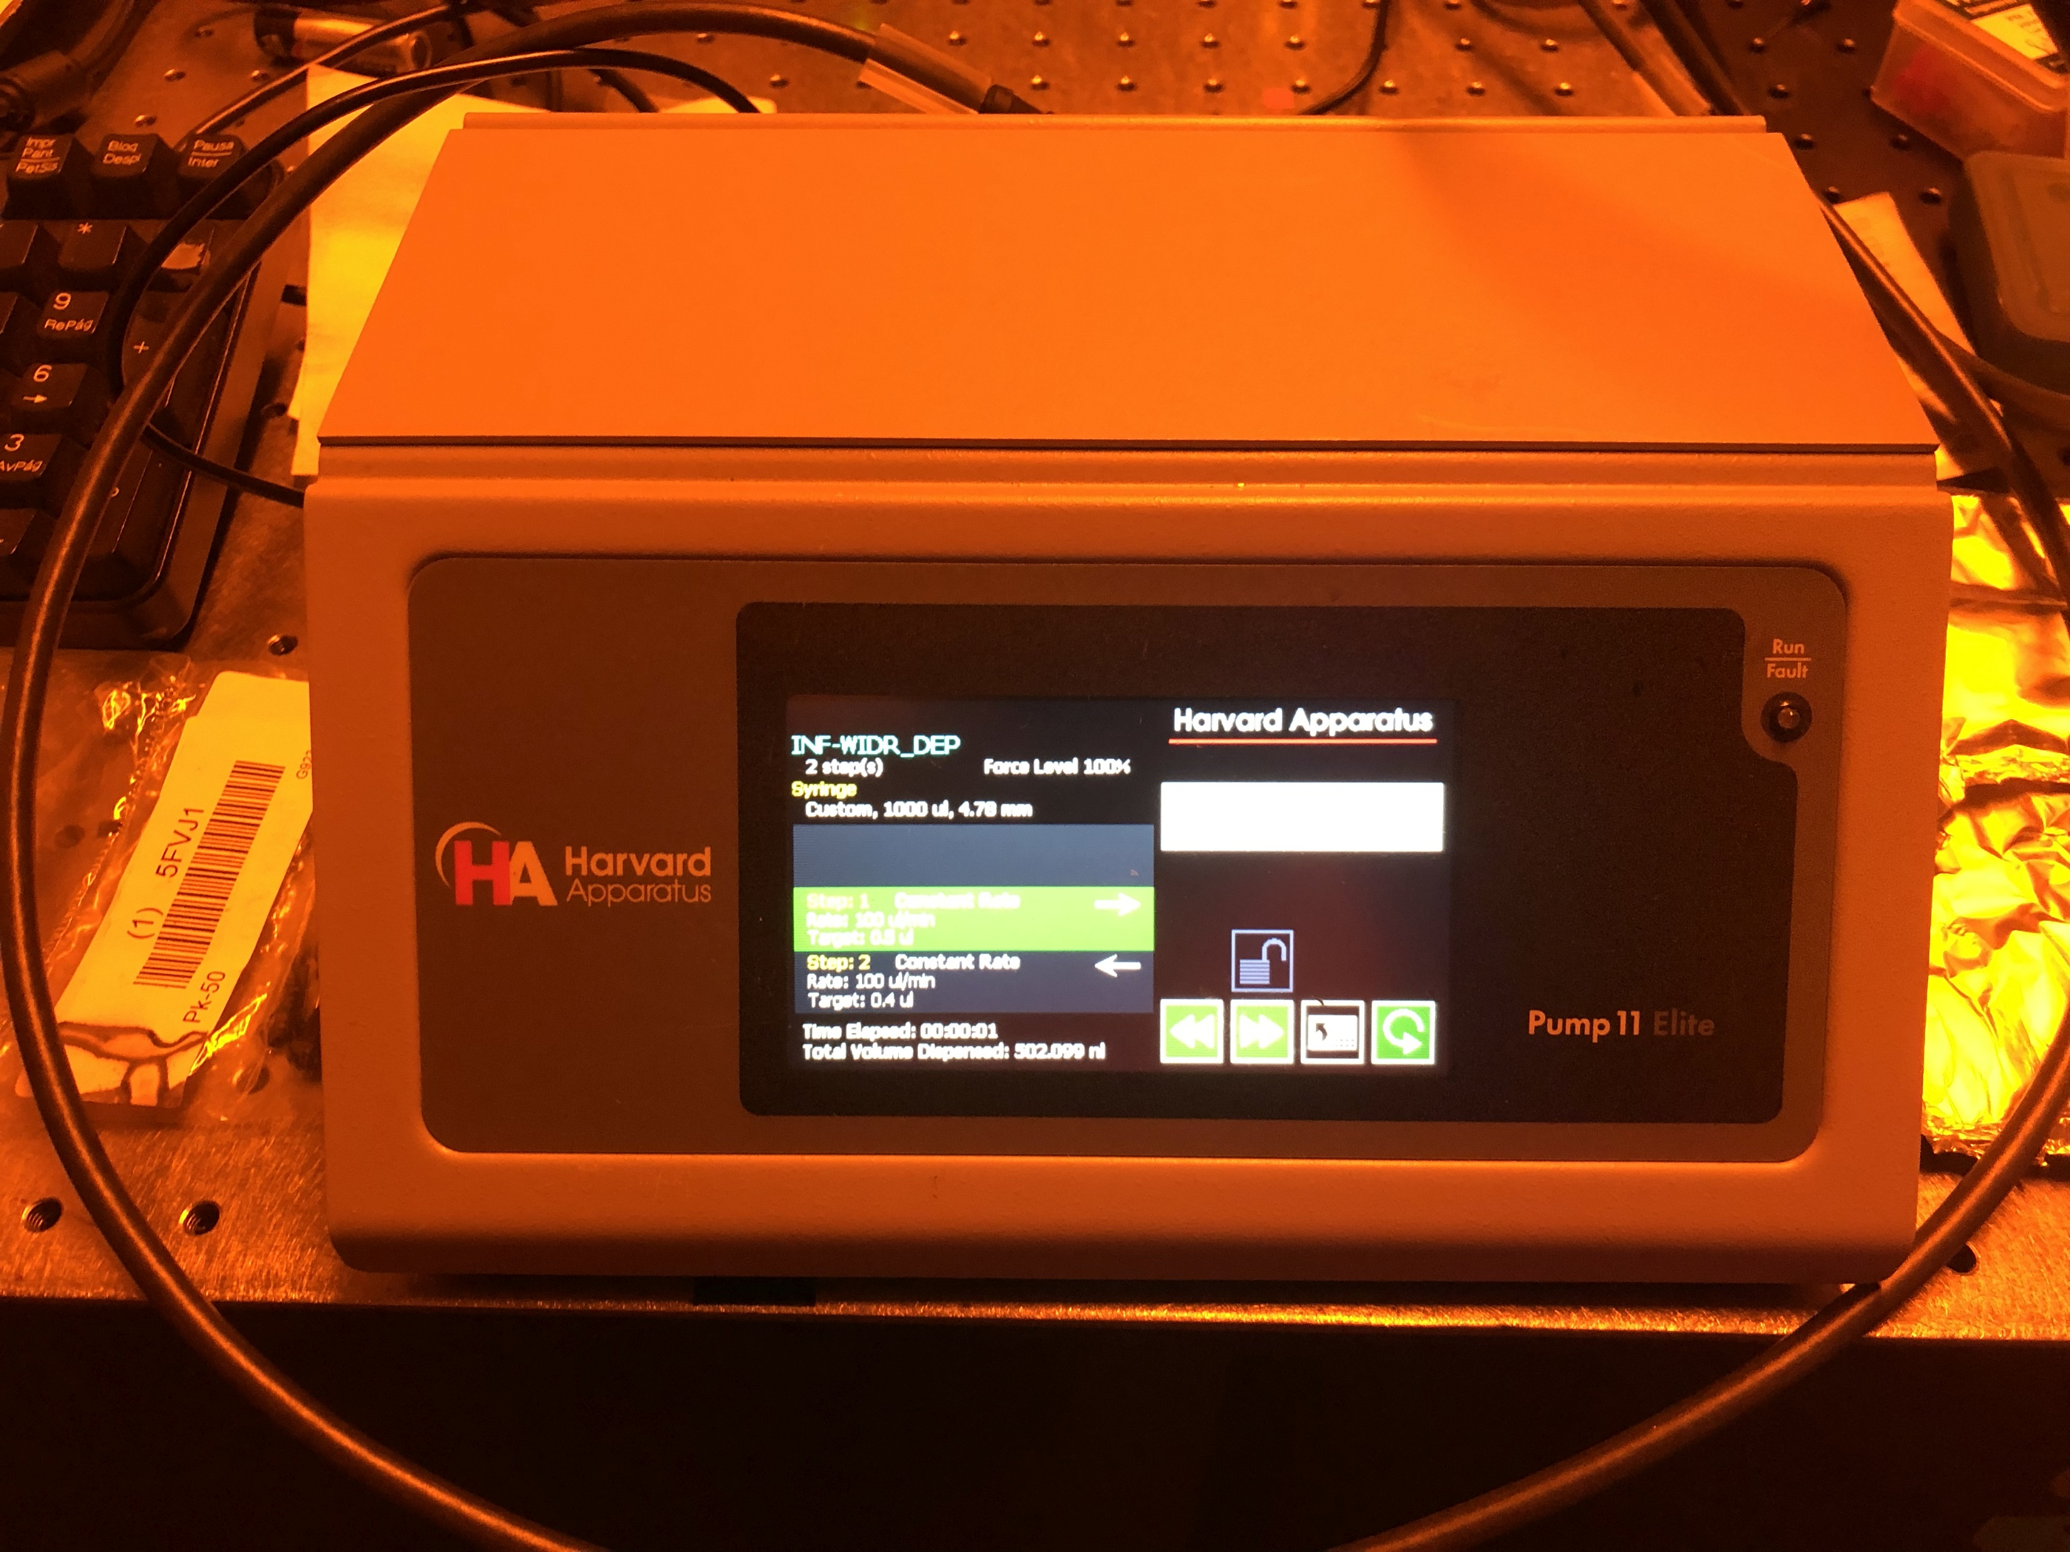

Slide 13
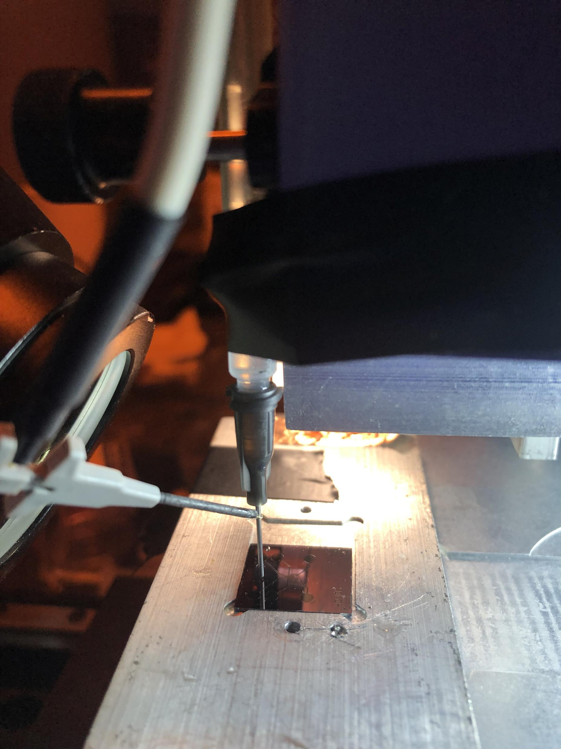
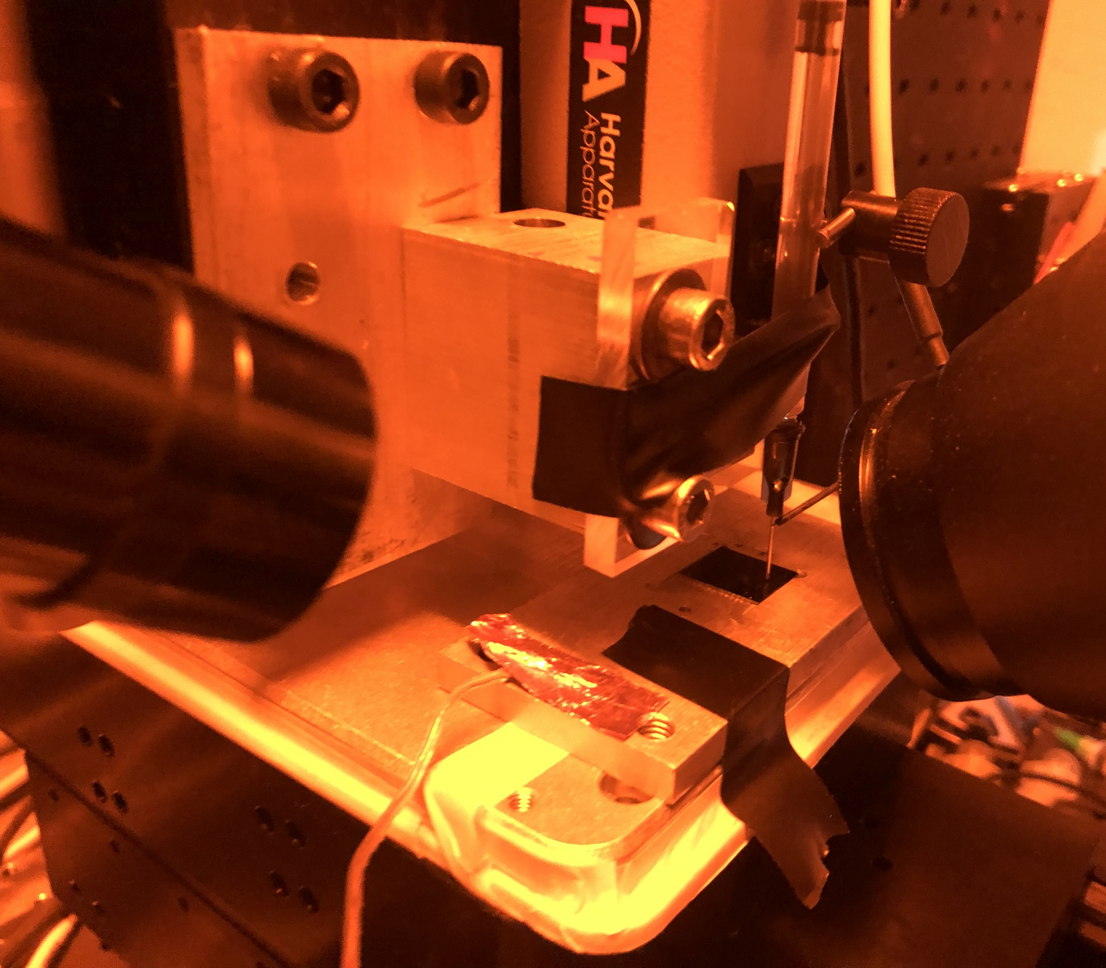

Slide 14
PEO Solution
The EMS polymer solution consisted of
2ml of SU-8 2002 mixed with
0.5 wt% of Poly(ethylene oxide) (PEO, 4,000,000 MW; SigmaAldrich Inc., Cat. N. 189464) and
0.5 wt% Tetrabutylammonium Tetrafluoroborate salts (TBATFB; SigmaAldrich Inc., Cat. N. 217964) to increase its conductivity and allow smooth polymer flow during electrospinning.
All reagents were used as received. Magnetic stirring of these components was performed for 1hr at 75°C and low rpm (100-150 rpm).

Slide 15
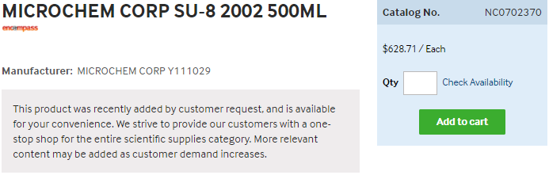
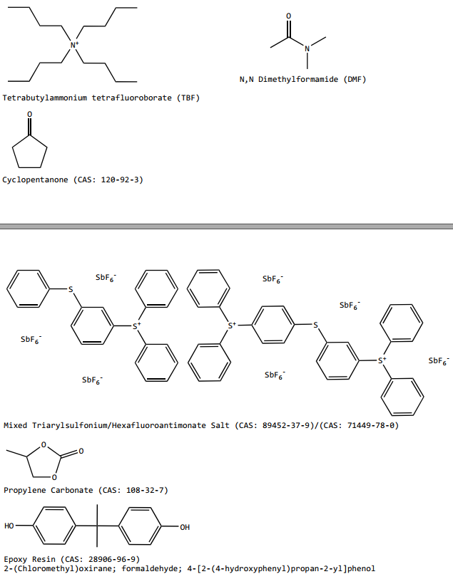
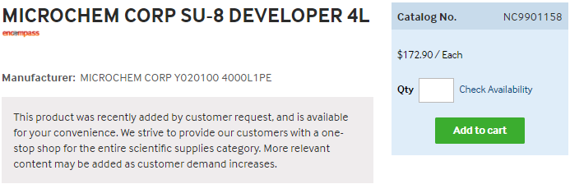
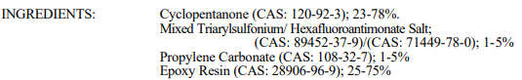
https://www.fishersci.com/shop/products/NC0702370/nc0702370#?keyword=MICROCHEM+CORP+PHOTORESIST+SU-8
https://www.fishersci.com/shop/products/NC9901158/nc9901158#?keyword=SU-8++developer
Notes:
https://rsc.aux.eng.ufl.edu/_files/msds/309.pdf

Slide 16
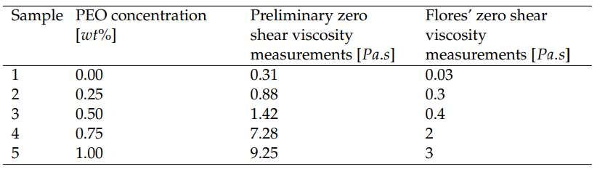
Zero shear viscosity measurements and Flores’ measurements
Both measurements have the same behaviour with similar proportions.
However, the results show that the current measured values are approximately three times larger than Flores’ measurements.

Slide 17
References
Cárdenas, B. (2017). Advanced Manufacturing Techniques for the Fabrication and Surface Modification of Carbon Nanowires, 160.
Flores, D. R. (2017). Role of rheological properties in near field electrospun fibers morphology, 130.

Slide 18
<subTitle>
<content> <key concept>

